Slide 1


Slide 2
Using LMC Assembly
Doing Things With The Little Man Computer

Slide 3
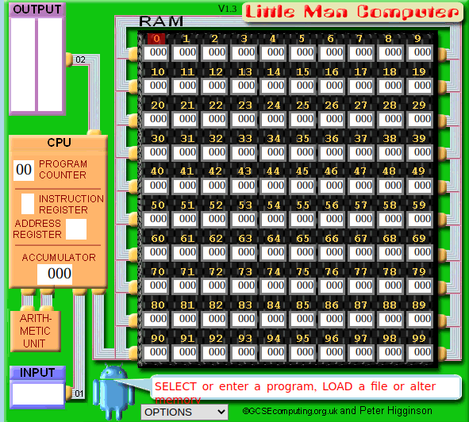
LMC Review
Recall the LMC architecture
Program Counter
Instruction & Address registers
Accumulator register for work
Input/Output areas
An ALU
100 memory slots
Notes:
Can be found online… but I can’t link to it

Slide 4
LMC Review
LMC Execution Cycle
Check the Program Counter
Fetch the instruction from that address
Increment the Program Counter
Decode the fetched instruction into the Instruction and Address registers
Fetch any data needed
Execute the instruction
Branch or store the result
Repeat!
Notes:
Can be found online… but I can’t link to it

Slide 5
LMC Review
LMC Instructions
ADD addition
SUB subtraction
STA store to memory
LDA load from memory
BRA unconditional branch
BRZ branch if zero
BRP branch if positive
INP get user input, put in acc
OUT output acc to output area
HLT/COB halt
DAT data
Notes:
Can be found online… but I can’t link to it

Slide 6
LMC Review
We will be using the excellent LMC simulator at https://peterhigginson.co.uk/LMC/
Notes:
Can be found online… but I can’t link to it

Slide 7
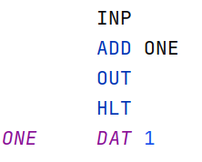
Add One
Our first program is going to be extremely simple
Ask the user for a number, add one to it, and then output the number
Notes:
Can be found online… but I can’t link to it

Slide 8
Add One
INP - get user input and put it in the accumulator
ADD ONE - add the number stored at the label ONE to the value in the accumulator
OUT - output the value in the accumulator to the output area
HLT - stop execution
Notes:
Can be found online… but I can’t link to it

Slide 9
Add One
ONE DAT 1 - Store the value 1 at the “current” position and make it available for reference with the label “ONE”
Not too bad, right?
This is a simple program but gives you the general flavor of assembly programming
Notes:
Can be found online… but I can’t link to it

Slide 10
Count Down
Let’s do something more complex: Print the numbers 10 to 1 in decreasing order
How could we do that?
Notes:
Can be found online… but I can’t link to it

Slide 11
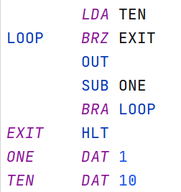
Count Down
Let’s do something more complex: Print the numbers 10 to 1 in decreasing order
Notes:
Can be found online… but I can’t link to it

Slide 12
Count Down
LDA - load the number 10 into the accumulator
BRZ - If the accumulator is 0, branch to EXIT
OUT - Else, print the accumulator
SUB - subtract 1 from the accumulator
Notes:
Can be found online… but I can’t link to it

Slide 13
Count Down
BRA - unconditionally jump back to the start of the loop
HLT - Halt (exit)
ONE, TEN - Data slots to hold constants
Notes:
Can be found online… but I can’t link to it

Slide 14
Count Down
This demonstrates two higher level programming language concepts:
Conditional logic (if statements)
Looping (for, do, while)
Compilers take your higher level programming language constructs, like the while loop in C, and create instructions like this
Notes:
Can be found online… but I can’t link to it

Slide 15
MAX
So far we haven’t had to worry too much about data sizing
Our computations have fit in the accumulator
Sometimes not all the working data can fit in the available registers
What to do?
Notes:
Can be found online… but I can’t link to it

Slide 16
MAX
Max: “Ask the user for two numbers and print the maximum of the two”
Now we are in trouble: we need to computer the difference between the two numbers, but we also need to keep the numbers around to print the correct value
Notes:
Can be found online… but I can’t link to it

Slide 17
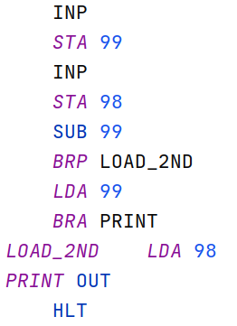
MAX
So we have three values that we are interested in
The first number entered
The second number entered
The difference between them
We are going to have to store numbers somewhere in memory to make this all work
Notes:
Can be found online… but I can’t link to it

Slide 18
MAX
As a convention, to avoid stepping on the program memory, we will use the TOP of the memory space to store the values
This is a proto-stack!
If we create a calling convention (covered later) we could define a MAX function here
Notes:
Can be found online… but I can’t link to it

Slide 19
MAX
INP - Get user input
STA 99 - Store the first number at position 99
INP - Get user input again
STA 98 - Store the second number at position 98
Notes:
Can be found online… but I can’t link to it

Slide 20
MAX
SUB 99 - Subtract the number at position 99 from the accumulator
NB: the value in the accumulator is also the value at 98
If we had not stored the second value at 98, it would now be lost (unless we did some math)
Notes:
Can be found online… but I can’t link to it

Slide 21
MAX
Now the magic: The accumulator stores the difference between the two numbers
If the first number is greater than the second number, it is positive
Else, it is negative
Notes:
Can be found online… but I can’t link to it

Slide 22
MAX
BRP - branch if the number is positive to the instruction that loads the second number back into memory
Else LDA - load the first number into memory and then branch to PRINT
LDA - load the second number into memory
Notes:
Can be found online… but I can’t link to it

Slide 23
MAX
OUT - print the current number in the accumulator to output and halt
Note how the control flow works here, implementing an if/else
Notes:
Can be found online… but I can’t link to it

Slide 24
MAX - Questions
How would we convert this from a MAX to a MIN computation?
How could we avoid storing the second value?
Can we avoid storing the first value?
Notes:
Can be found online… but I can’t link to it

Slide 25
Practical LMC
In this lecture you have seen how to implement some basic algorithms in LMC assembly
Using branch instructions, we are able to implement rudimentary loops and conditional execution
We only have one working register, the accumulator, so we have to store values in memory if the working set of data is larger than one value

